Slide 1



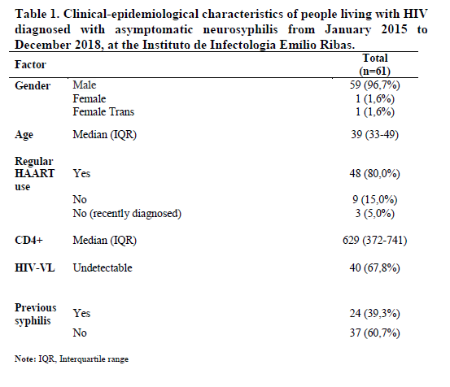

Clinical and laboratory aspects of patients with asymptomatic neurosyphilis and HIV infection treated with ceftriaxone: A retrospective cohort.
AL.CC Toscano, JE Vidal, TNL Souza, EP Athaide Filho
EMILIO RIBAS INFECTIOUS DISEASES INSTITUTE,
São Paulo, SP – Brazil.
Background: People living with HIV/AIDS (PLWHA) have higher rates of persistence of T. pallidum in the CNS even in the early stages of syphilis, leading to higher rates of neurological involvement.. Current recommendations indicate the preferential use of crystalline penicillin for all neurosyphilis presentations. However, ceftriaxone has greater dosage convenience than crystalline penicillin. This study aims to describe data from PLWHA diagnosed with asymptomatic neurosyphilis treated with ceftriaxone at Emilio Ribas Infectious Diseases Institute (IIER). Methods: An observational, retrospective cohort was conducted from 2015-2018 at IIER. Eligibility criteria were age 18+, HIV+; first diagnosis of neurosyphilis; use of ceftriaxone (10-14 consecutive days). Patients with symptomatic neurosyphilis were excluded. Information analyzed included demographic, previous syphilis occurrence, stage of syphilis, serum findings, CD4 T cell count (CD4+), HIV viral load (HIV-VL), regular use of ART and post treatment laboratory response (evaluated within 12 months after neurosyphilis diagnosis).. Fisher's exact tests were used for for univariate and binary logistic regression. A p value <0.05 was considered statistically significant.
Results: A total of 149 patients were identified. Sixty-one individuals were included in the final analyzes (Table 1). Males accounted 96.7% of cases, with mean age of 39 years. The median CD4+ was 629 cells/mm³ and 80% of participants were on HAART. Twenty-four (39.3%) had previously been diagnosed with syphilis. 86.2% had normalization of serum and/or CSF VDRL titres. Forty-nine (80.3%) patients had control serum VDRL records, form which 38 (77.5%) had adequate titration reduction within 12 months. Thirty-four patients (55.7%) had control CSF VDRL, 27 (79.4%) with adequate response within 12 months (Table 2). Twenty-one patients achieved CSF cell count reduction. Undetectable HIV-VL was higher (although not statistically significant) in the group with CSF response (90.4%) p = 0.071. Twenty (74.0%) patients with adequate reduction in CSF titre, had a serum control exam. An adequate reduction in serum VDRL was observed in 16 (80%) patients. A similar percentage value (83.3%) was found for adequate serum response among individuals without CSF response.
Conclusions: In our study, most of our patients were young males, in a work active age and high levels of CD4+. Ceftriaxone allows treatment in Day Hospital regime and might be considered as an alternative to treat neurosyphilis in PLHIV.
e-mail: aluizaconde@gmail.com
PRESENTED AT THE 23RD INTERNATIONAL AIDS CONFERENCE (AIDS 2020) | 6-10 JULY 2020

